Slide 1
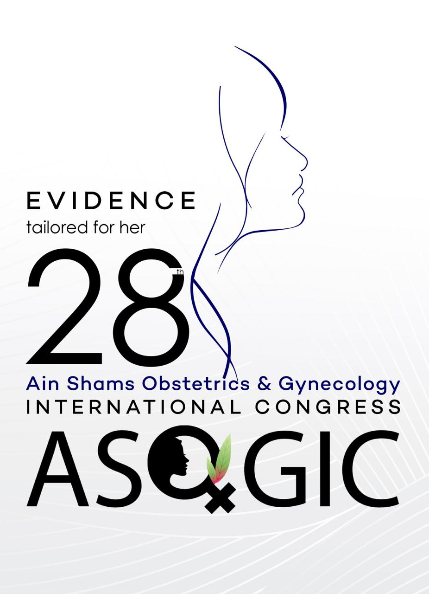

Building the Sterile Foundation SKIN PREPARATION AND DRAPING
ASOGIC 28 Basic Surgical Skills Workshop
Hamdy Bakry Alqenawy, MD
Clinical Lecturer in O&G Ain Shams University
8 August 2025

Slide 2
Outline
Purpose & principles
Skin prep solutions & technique
Draping to maintain sterile field

Slide 3
DECONTAMINATING THE FIELD

Slide 4
Why Asepsis is Crucial
Surgical Site Infections (SSIs) are a major complication.
Effective skin prep and draping are our first line of defense.
Impact:
Patient safety
Reduced morbidity/mortality
Shorter hospital stays
Cost savings

Slide 5
Principles of Skin Antisepsis
Acts on microbial flora on the skin to
Eliminate transient flora
Reduce resident flora
Key Concepts:
Mechanical Action: Friction helps remove dirt and loose microbes.
Chemical Action: Antiseptic agents kill or inhibit microbial growth.
Contact Time & Drying: Crucial for antiseptic efficacy and preventing flammability.
Direction: “Clean to Dirty” – from the incision site outwards.

Slide 6
Common Antiseptics
Povidone-Iodine (Betadine):
Pros: Broad spectrum, residual effect.
Cons: Inactivated by organic matter, potential for skin irritation/allergy.
Chlorhexidine Gluconate (CHG):
Pros: Broader spectrum than iodine, persistent activity, effective in presence of organic matter.
Cons: Avoid near eyes/ears, potential for skin irritation.
Alcohol (Isopropyl/Ethyl):
Pros: Rapid kill, excellent degreaser.
Cons: Flammable, no residual activity. Often combined with CHG or Iodine.

Slide 7
Practical Tips
Always check patient allergies (latex/iodine) and the manufacturer’s instructions for use.
Povidone-iodine? Scrub vs Paint
Alcohol?

Slide 8
Preoperative Skin Preparation: Steps
Pre-surgical hygiene
Recommend bathing with antiseptic (e.g. CHG) the night before or morning of surgery
Jewelry and nail polish removal
Hair removal
Avoid shaving; if necessary, clipping <2 h prior to surgery
Positioning & site identification
Define the surgical field, extending well beyond the anticipated incision

Slide 9
Preoperative Skin Preparation: Steps
Antiseptic selection & application
Use alcohol-based combo (CHG or iodophor + alcohol) for rapid and persistent action
Apply antiseptic in a single, continuous motion, starting at the incision site and moving outwards in concentric circles.
Do not re-enter the prepped area with the same applicator.
Do NOT blot. Air dry completely (≥3 min). This ensures antiseptic action and prevents pooling/fire risk.
Practical Tip: Don’t forget to thoroughly clean the umbilicus, skin folds, and any stomas.

Slide 10
ESTABLISHING THE STERILE BARRIER

Slide 11
Draping: Essentials & Purpose
Types: towels, sheets, fenestrated, adhesive/incise, extremity stockinette
Use sterile, flame-resistant, lint-free drapes; maintain fluid barriers
Functions:
Isolate the incision from non-sterile skin/surfaces.
Provide a barrier against microbial migration.
Absorb fluids and contain contaminants.
Define the sterile working area for the surgical team.

Slide 12
Principles of Aseptic Draping
Minimal handling (with sterile gloves) as little as possible to prevent contamination.
Drapes remain within sterile field. Never reach across a non-sterile area to drape. Keep safe distance (12 inches).
Protect your gloved hands by cuffing the drape over them when unfolding.
Secure edges to prevent movement. Once a drape is placed, do not move it towards the sterile field.
Use impervious layers; replace if wet or contaminated to maintain barrier integrity.
Consider anything below table level or off the edge of the table as non-sterile.

Slide 13
Steps for Aseptic Draping
Place sterile towels/sheets to square off incision area
Apply fenestrated drape over site
Place the top drape to create a barrier between the sterile field and the anesthesia area. Add additional drapes/sheets as needed (e.g. extremity drapes)
Secure with non-perforating towel clamps or adhesives; avoid repositioning
Practical Tip: Unfold drapes away from yourself and the patient, allowing gravity to assist.

Slide 14
Evidence-Based Highlights
Alcohol + CHG/iodophor combos outperform single agents in reducing SSI
Clipping <2 h pre-op preferred over shaving—significantly lowers SSI risk
Adhesive incise drapes don’t show clear SSI reduction and aren’t routinely recommended

Slide 15
Suggested Reading
WHO (2018): Global Guidelines for the Prevention of Surgical Site Infection. World Health Organization.
NICE (2020): Surgical site infections: prevention and treatment. National Institute for Health and Care Excellence.
CDC (2017): Guideline for the Prevention of Surgical Site Infection. Centers for Disease Control and Prevention.
AST (2014): Standards of Practice for Skin Prep of the Surgical Patient & Establishing the Sterile Field. Association of Surgical Technologists.
AORN (2022): Preoperative Patient Skin Antisepsis. Association of periOperative Registered Nurses.

